Slide 1
Adding The MongoDB Driver To Nodejs
V.Yashwanth Reddy
22H51A05T3

Slide 2
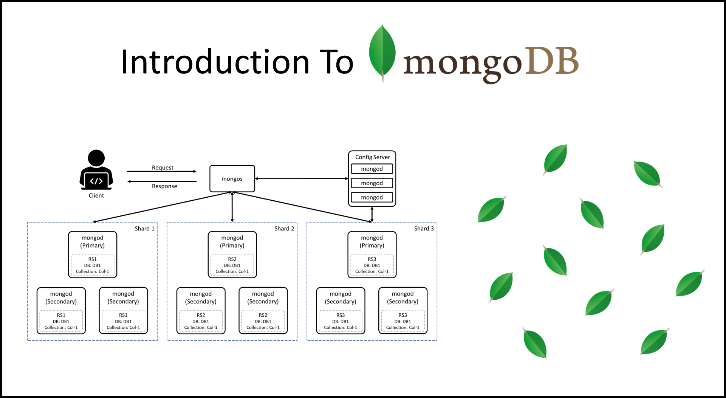
Introduction to MongoDB and Node.js
MongoDB is a NoSQL database that stores data in a flexible, document-oriented format.
Node.js is a JavaScript runtime built on Chrome's V8 engine, enabling server-side development.
Combining MongoDB with Node.js allows for efficient handling of data-driven applications.
1
Notes:
Image source: https://digitalvarys.com/introduction-to-mongodb/

Slide 3
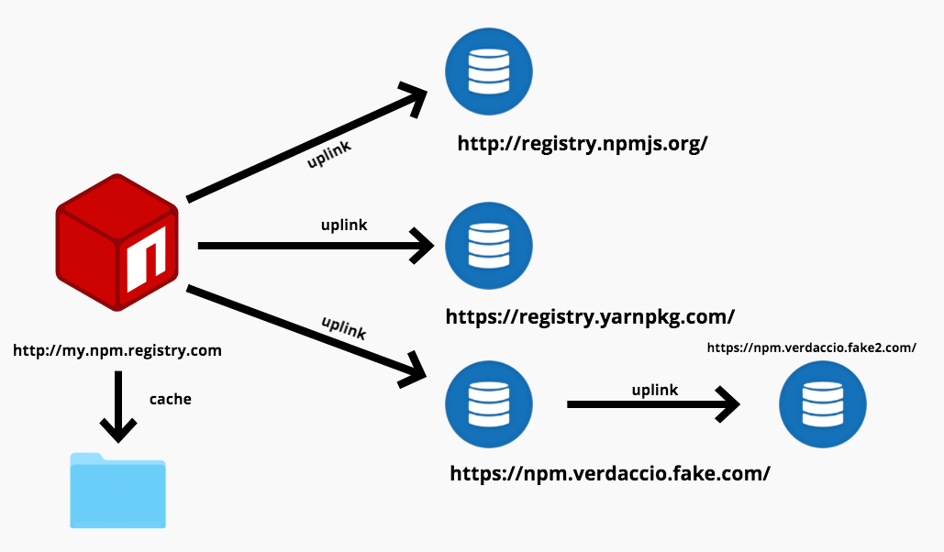
Prerequisites for Installation
Ensure you have Node.js and npm (Node Package Manager) installed on your machine.
Familiarity with JavaScript and basic Node.js concepts will be beneficial.
It is also essential to have a running instance of MongoDB, either locally or in the cloud.
mongodb://localhost:27017/
2
Notes:
Image source: https://www.boardinfinity.com/blog/a-quick-guide-to-npm/

Slide 4
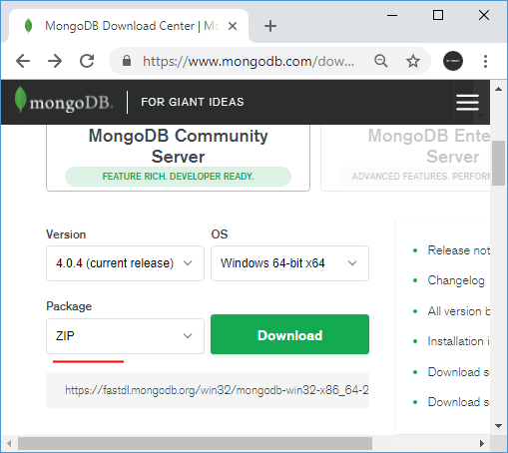
Installing the MongoDB Driver
Open your terminal or command prompt to start the installation process.
Use the npm command `npm install mongodb` to add the MongoDB driver to your project.
This command will download the driver and add it to your project's `node_modules` directory.
3
Notes:
Image source: https://www.sqlsplus.com/installing-mongodb-and-start-working-with-mongodb-on-windows/

Slide 5
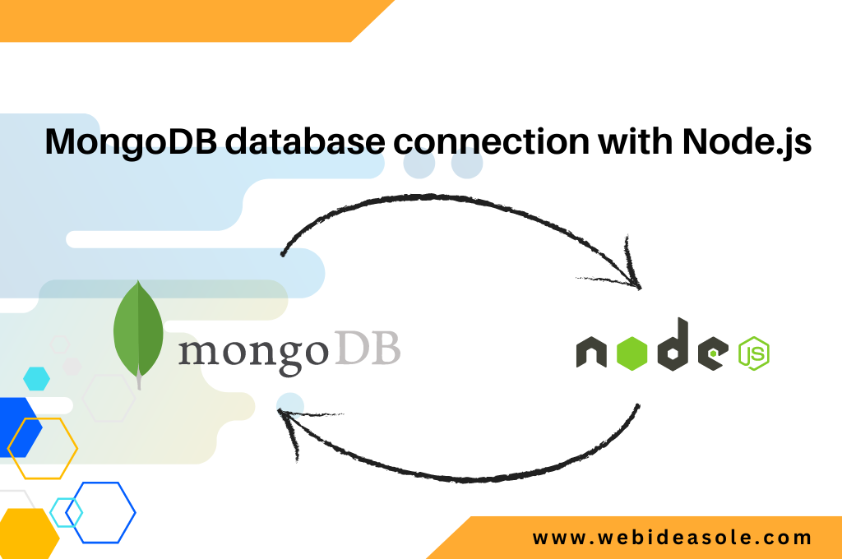
Connecting to MongoDB
To connect to MongoDB, require the MongoDB client in your Node.js application.
Use the `MongoClient.connect()` method with your MongoDB URI to establish a connection.
Make sure to handle connection errors appropriately to ensure smooth operation.
4
Notes:
Image source: https://webideasole.com/how-to-connect-the-mongodb-database-with-nodejs-store-data/

Slide 6
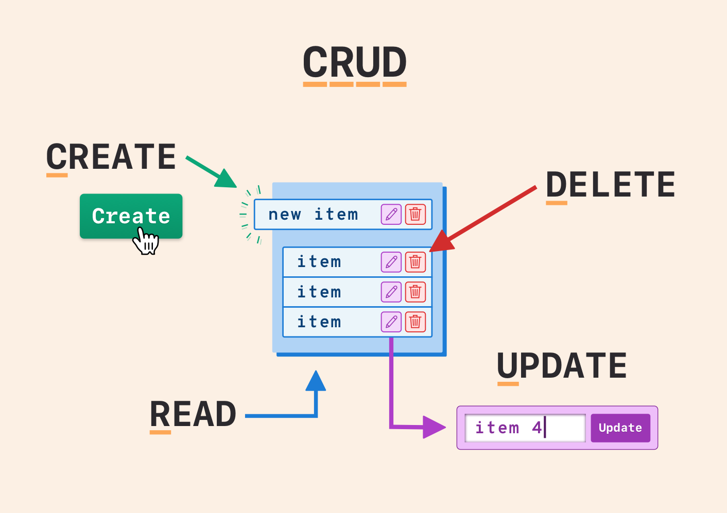
Performing CRUD Operations
CRUD stands for Create, Read, Update, and Delete, which are the basic operations for database interaction.
Use the appropriate methods such as `insertOne()`, `find()`, `updateOne()`, and `deleteOne()`.
Each operation returns a promise, allowing for asynchronous handling of database tasks.
5
Notes:
Image source: https://www.almuhja.com/p/how-to-build-a-crud-app-for-your-database

Slide 7
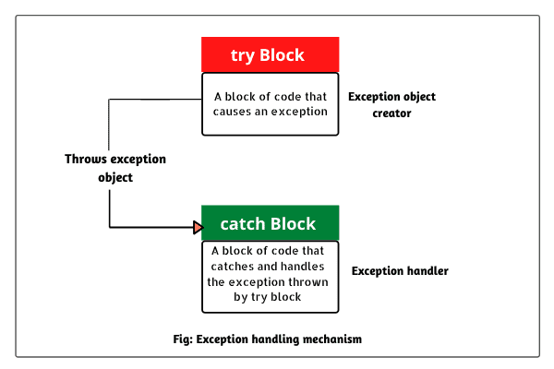
Error Handling and Debugging
Implement try-catch blocks to catch errors during database operations effectively.
Use console logs for debugging to track the flow of data and identify issues.
Consider utilizing MongoDB's built-in logging for more detailed insights into database operations.
6
Notes:
Image source: https://www.vrogue.co/post/exception-handling-using-try-catch-in-sql-server-stored-procedures

Slide 8
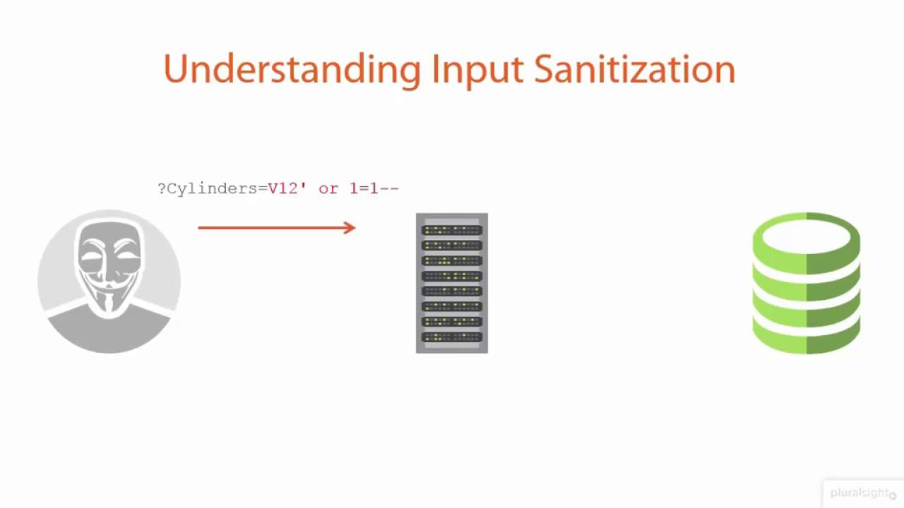
Best Practices
Always sanitize input data to prevent injection attacks and ensure data integrity.
Use connection pooling to optimize performance for high-load applications.
Regularly update the MongoDB driver to benefit from performance improvements and security patches.
7
Notes:
Image source: https://www.youtube.com/watch?v=WfxQhjZYvGQ

Slide 9
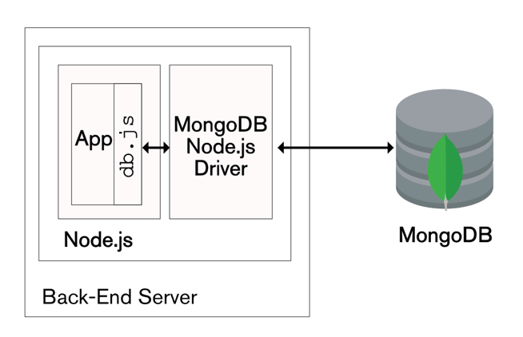
Conclusion
Adding the MongoDB driver to Node.js is a straightforward process that enhances application capabilities.
Mastering MongoDB and Node.js together opens up numerous possibilities for data-driven applications.
Continue exploring MongoDB's features to build robust and scalable applications efficiently.
8
Notes:
Image source: https://www.mongodb.com/blog/post/the-modern-application-stack-part-2-using-mongodb-with-nodejs

